Slide 1



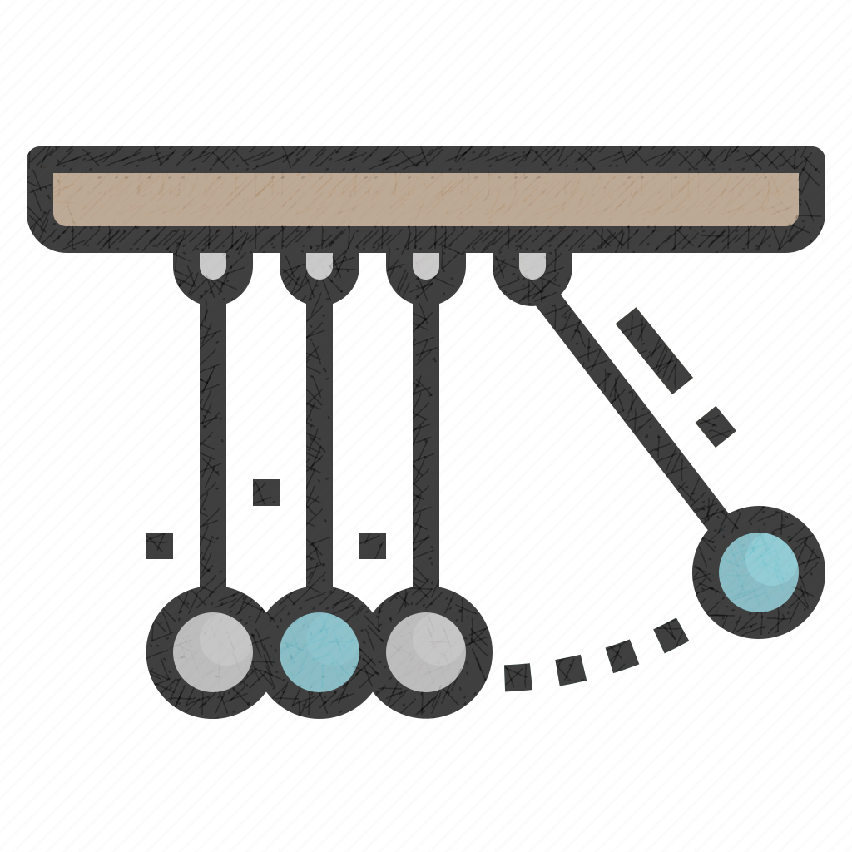
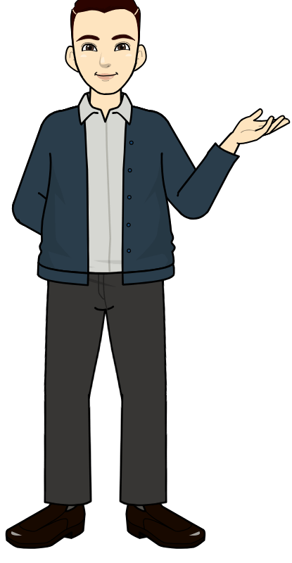
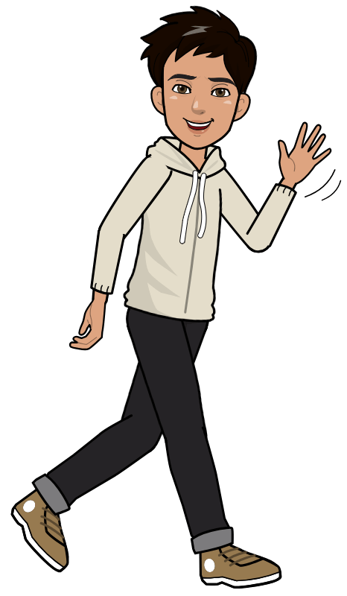
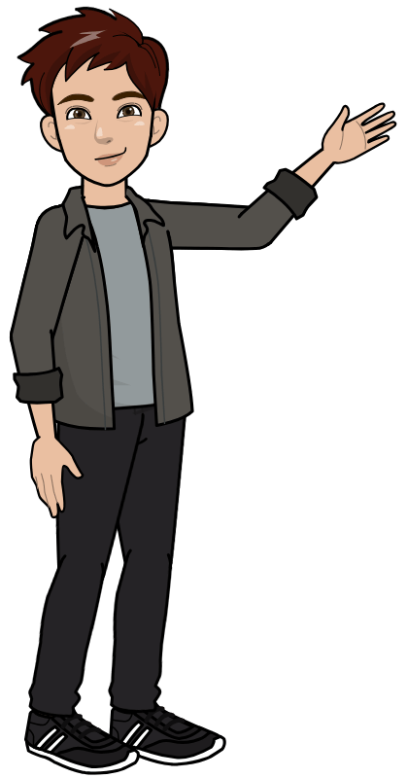
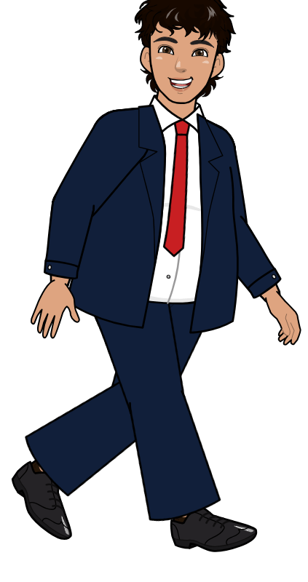

ERROR -119
Problem Sector – Education
CipherThon 2.0

Slide 2
Introduction to Team
This team includes a bunch of electrified first year computer science bachelor’s students namely, Saurabh Mishra (lead), Imran Siddiqui, Dev Kumar, Ayush Kumar and Aman Patel. We are excited to showcase our coding prowess and simultaneously learn from the seasoned developers and mentors. We as a team come together to present a challenging front with each member presenting their unique abilities to produce a great model to better public services.

Slide 3
THE PROBLEM STATEMENT
Education – ED1
EDPS – 02
Navigating Obstacles to Course Completion: Challenges in Educational Technology
The current landscape of educational technology faces a persistent challenge in ensuring effective course completion by students. Students often encounter obstacles that hinder their progression through online courses, leading to incomplete learning experiences and unrealized educational goals.

Slide 4
PROPOSED SOLUTION
The solution to this problem statement that error-119 proposes is a comprehensive learning platform which provides a personalized learning experience to every student
The learner can visit our platform to gain in-depth understanding of topics of their choice where they will be provided with a complete package of videos, written notes and assignments to grasp the essence of the course that they complete with us.
Our USP here is that we will provide our individual learner with a personalized roadmap with timings of their choice and two way interaction to create a wholesome learning environment.
The platform will also host multiple weekly, monthly and annual events to pique pupil’s interest and help the platform stay interested.

Slide 5


BENEFITS AND impacts
Implementation plan
We aim to provide multiple benefits at a single place with our platform. We want our users to forget the hassle of learning from multiple platforms and the regret that comes when not being able to fulfill their goals.
With the personalised learning map, we plan to provide our learners with the goals that they can achieve at their acceptable pace.
The student will stay interested with multiple events and competitions that will be conducted on our platform.
We believe that the this roadmap will provide the students with the right amount of uplift to do better in their courses.
In turn, we want to work towards creating a better education system for the universal learners’ community.

Slide 6
Implementation plan
The implementation plan requires an overall development of website with frontend using HTML5, CSS and JavaScript.
The page will implement an interactive graphics created using Figma and Canva.
The backend of the platform will require working with PHP and storing data with the help of MySQL.

Slide 7

conclusion
In conclusion, the current scenario for overall learning is not the optimum solution for the users. With our platform we will bridge the gap present in the digital world, and provide the best possible solution for our learners. We are dedicated to work towards a platform which is designed with the best in mind for the students.

Slide 8
Thank you!!

